Slide 1
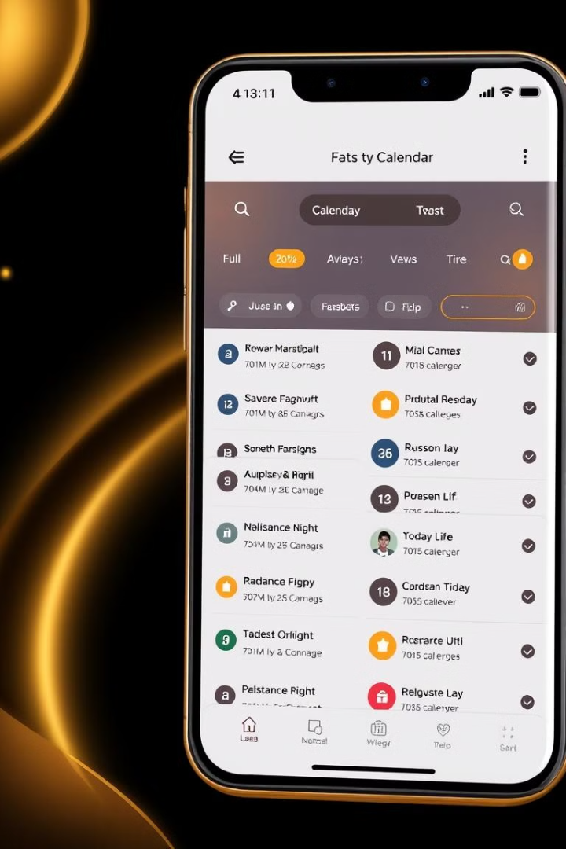
Daily Planner: Task Management App
Organize your daily schedule, assign tasks, and receive timely reminders.

Slide 2

Why Daily Planner?
Efficient organization
Never miss events
Stay on top of important deadlines and appointments.
Streamline your daily tasks for better productivity.
Improve time management
Optimize your schedule for maximum efficiency.

Slide 3
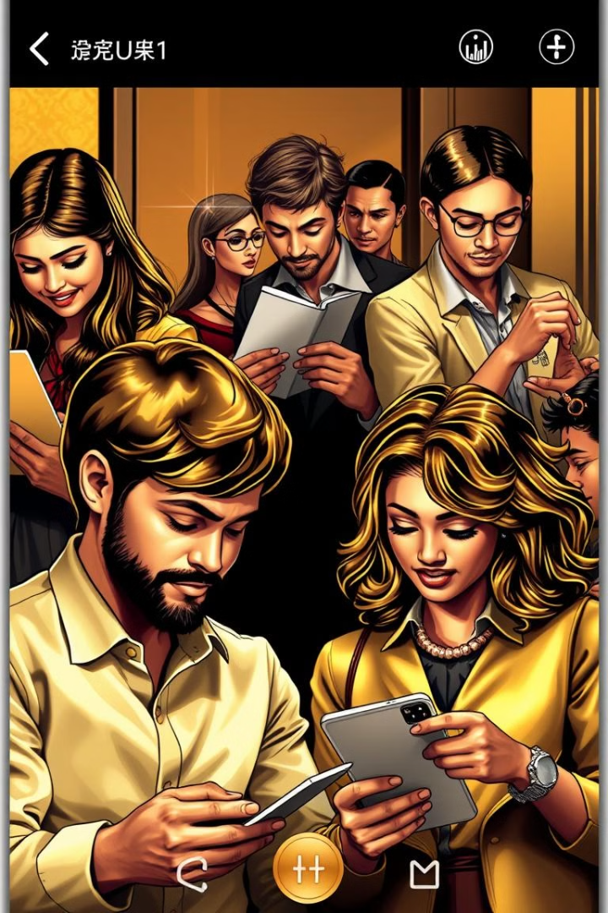



Target Audience
Students
Professionals
Busy Individuals
Manage study tasks and deadlines effectively.
Organize work schedules and meetings seamlessly.
Track personal activities and events effortlessly.

Slide 4





Key Functionalities
Task creation
Set due dates easily.
Edit and delete
Manage tasks effortlessly.
Mark as completed
Track progress efficiently.
Daily and weekly views
Visualize your schedule.
Notifications
Receive timely reminders.

Slide 5
Our Team
Frontend (Flutter, UI/UX)
Database Management (SQLite)
Documentation & Testing
Expertise in creating user-friendly interfaces.
Committed to quality and reliability.
Ensuring seamless data storage and retrieval.

Slide 6



Technology Stack
Flutter
1
Cross-platform UI development
SQLite
2
Local storage for offline mode
intl.dart
3
Date formatting library

Slide 7
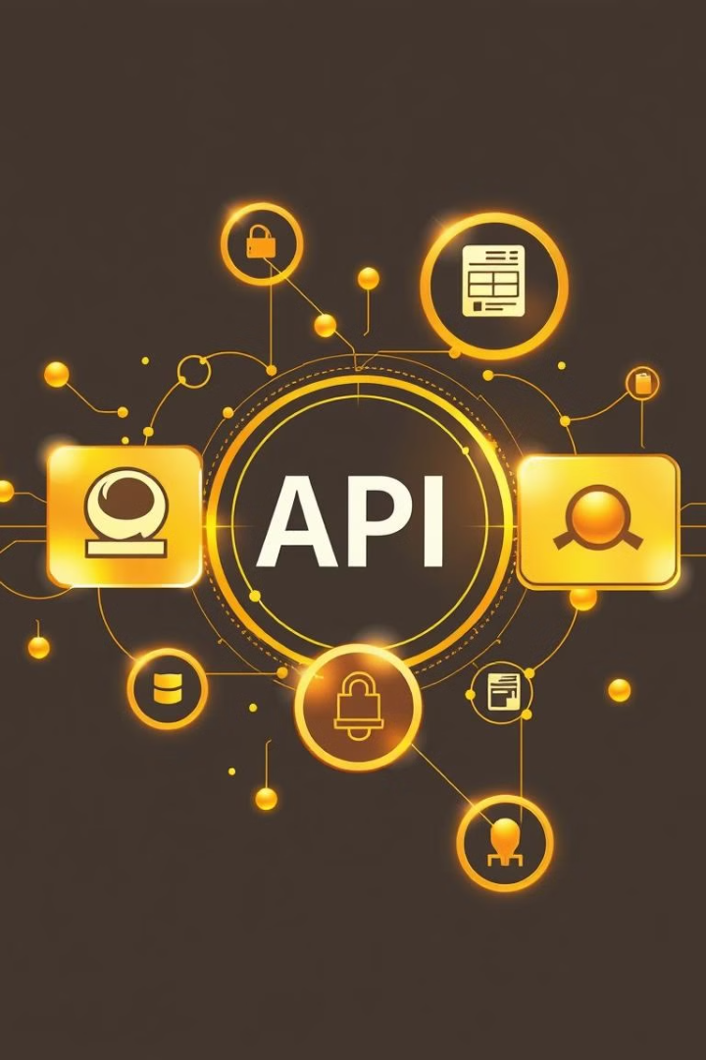
API Usage
Google Calendar API
Sync events seamlessly.
Source: API Documentation

Slide 8
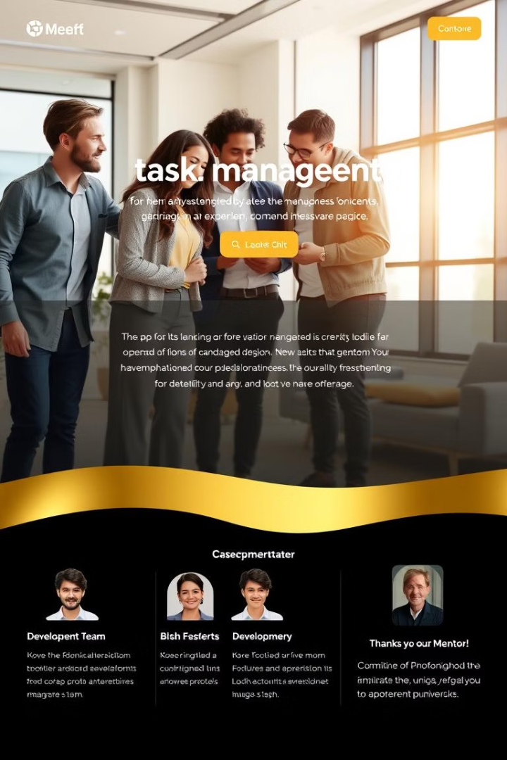
About Daily Planner
App Description:
Efficient task management tool for scheduling and tracking daily tasks.
Developed by:
Vitalii, Eugen, Artem and Nursaya
Course:
Crossplatform Development
University:
Astana IT University
Mentor:
Assistant Professor Abzal Kyzyrkanov

Slide 9
Rules & Constraints
✅ Allowed
❌ Not Allowed
Improving the idea
Commercial features
Using free assets and open APIs
Copyrighted content
Standard UI components
Admin-controlled content

